Slide 1
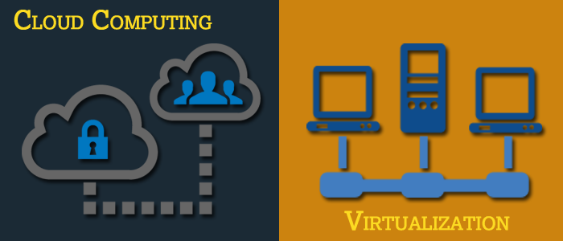
Basics of Virtualization and Cloud Technology

Slide 2
Chapter 1: Overview of Virtualization

Slide 3
Overview of Virtualization
Why do you need virtualization?
What is virtualization?
Virtualization in current IT scenario
Comparing virtualized and non-virtualized environment

Slide 4
History of Virtualization
The virtualization concept is believed to have its origins in the mainframe days in the late 1960s and early 1970s.
IBM invested a lot of time and effort in developing robust time-sharing solutions.
<NOTE> Time-sharing refers to shared usage of computer resources among a large group of users, aiming to increase the efficiency of both users and expensive computer resources they share.
Due to virtualization, the cost of providing computing capability dropped considerably and it became possible for organisations, and even individuals, to use a computer without actually owning one.
The capacity of a single server is so large that it is almost impossible for most workloads to effectively use it. The best way to improve resource utilisation and at the same time simplify data centre management, is through virtualization.
Datacenters today use virtualization techniques to make abstraction of physical hardware, create large aggregated pools of logical resources consisting of CPUs, memory, disks, file storage, applications, networking and offer those resources to users or customers in the form of agile, scalable and consolidated virtual machines.
Source: https://www.slideshare.net/adityathatte/session-1-fdp

Slide 5
The Need for x86 Virtualization
Virtualization was neglected during the 1980s and 1990s when the client-server applications and inexpensive x86 servers and desktops established the model of distributed computing
Rather than sharing the resources centrally in the mainframe model, organisations started using the low cost distributed systems to build large computing capacity.
The growth in x86 server and desktop deployments has introduced a new IT infrastructure and operational challenges.
Following are some of the challenges faced while using x86 server:
Low Infrastructure Utilisation:
Increasing Physical Infrastructure Costs:
Increasing IT Management Costs:
Insufficient Failover and Disaster Protection:
High Maintenance End-user Desktops:
Source: https://www.probrand.co.uk/it-services/vmware-solutions/history-of-virtualisation
Notes:
Low Infrastructure Utilisation: Typical x86 server deployments achieve an average utilisation of only 10% to 15% of total capacity, according to the International Data Corporation (IDC), a market research firm. Organisations typically run one application per server to avoid the risk of vulnerabilities in one application affecting the availability of another application on the same server.
Increasing Physical Infrastructure Costs: The operational costs to support growing physical infrastructure have steadily increased. Most computing infrastructure must remain operational at all times, resulting in power consumption, cooling and facilities costs that do not vary with utilisation levels.
Increasing IT Management Costs: As computing environments become more complex, the level of specialised education and experience required for infrastructure management personnel and the associated costs of such personnel have increased. Organisations spend disproportionate time and resources on manual tasks associated with server maintenance, and thus require more personnel to complete these tasks.
Insufficient Failover and Disaster Protection: Organisations are increasingly affected by the downtime of critical server applications and inaccessibility of critical end-user desktops. The threat of security attacks, natural disasters, health pandemics and terrorism have elevated the importance of business continuity planning for both desktops and servers.
High Maintenance End-user Desktops: Managing and securing enterprise desktops present numerous challenges. Controlling a distributed desktop environment and enforcing management, access and security policies without impairing users’ ability to work effectively is complex and expensive. Numerous patches and upgrades must be continually applied to desktop environments to eliminate security vulnerabilities.

Slide 6
Why virtualization is required in IT industry?
IT enterprises are implementing the concept of virtualization over the recent years due to its size, budget, staffing and resource constraints. Out of which, the budget and resource utilities have lead to heavy impediments for their exponential growth.
IT challenges, such as, low server utilisation, complex server-storage migration, inefficient server deployment, increased total cost of ownership, server sprawl, high-availability requirements, disaster-recovery complexity, green IT requirements, automation and policy driven management have led to the innovation called virtualization.
Virtualization is a technology to run multiple same or different operating systems which is completely isolated from each other. For instance, Run both Windows and Linux operating systems on the same machine.
Source: https://cloudtweaks.com/2012/12/the-history-of-virtualization/

Slide 7
Why Virtualize?
Following are the reasons for virtualization:
Server Consolidation and Infrastructure Optimization
Physical Infrastructure Cost Reduction
Improved Operational Flexibility and Responsiveness
Increased Application Availability and Improved Business Continuity
Improved Desktop Manageability and Security
Source: http://www.mpcl.in/virtualisation.html
Notes:
Server Consolidation and Infrastructure Optimization: Virtualization makes it possible to achieve significantly higher resource utilisation by pooling common infrastructure resources and breaking the legacy of “one application to one server” model.
Physical Infrastructure Cost Reduction: With virtualization, you can reduce the number of servers and related IT hardware in the data centre. This leads to reductions in real estate, power and cooling requirements, resulting in significantly lower IT costs.
Improved Operational Flexibility and Responsiveness: Virtualization offers a new way of managing IT infrastructure and can help IT administrators spend less time on repetitive tasks, such as, provisioning, configuration, monitoring and maintenance.
Increased Application Availability and Improved Business Continuity: Eliminate planned downtime and recover quickly from unplanned outages with the ability to securely backup and migrate entire virtual environment with no interruption in service.
Improved Desktop Manageability and Security: Deploy, manage and monitor secure desktop environments that end users can access locally or remotely, with or without a network connection, on almost any standard desktop, laptop or tablet PC.

Slide 8
Factors that justify the need for virtualization
Following justifies the need for virtualization:
Energy Management
Hardware and Operating Costs
Availability of Resources
Uninterrupted Business Continuity
Disaster Recovery Plans
Notes:
Energy Management: By consolidating the hardware resources, the number of servers can be reduced as much as possible. The power consumption for every server consumed is high; thus, by consolidating it, we can save power in order to utilise it for other resources. In other words, it’s economical to save power by virtualizing the servers.
Hardware and Operating Costs: Having too many physical servers, lead to requirement more room and maintenance. Instead, consolidate those servers and operate them efficiently at a lower cost by virtualizing these servers. By virtualizing these servers, companies can cut down their operating cost to a greater extent
Availability of Resources: The software applications that are to be used by n number of users can be made easily available through virtualization. By virtualizing these software s, each terminal in an organisation doesn’t need to have the software s and other supporting applications installed separately
Uninterrupted Business Continuity: Business continuity is the ability of an organisation to maintain essential functions during, as well as after, a disaster has occurred. Whenever a server hardware fails, the data has to be backed up instantly. By virtualizing this server, the data will be synchronised to a target virtual machine, and the physical server host doesn’t have to be turned off during a live migration, thus achieving a negligible downtime.
Disaster Recovery Plans: After a disaster has occurred, the time to come back to a normal state totally up and running again in order to avoid downtime

Slide 9
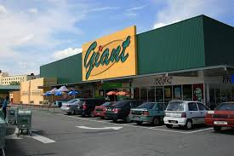
Case Study of Virtualization
Retail Chain Eases IT Manpower with Desktop Virtualization
Malaysia's supermart giant Mydin reduces the time needed to roll out new software patches from 120 man-hours to just 15 minutes and minimises the maintenance of thin-client devices due to desktop virtualization.
When it decided to deploy desktop virtualization, retail giant Mydin had the usual concerns associated with bandwidth and user resistance. So it focused most of its efforts on assuring employees about the benefits and is now reaping the rewards from better utilisation of its IT resources.
The Malaysia-based supermarket chain chalked up 2.1 billion ringgit (US$650.16 million) in revenue last year and is targeting to hit 2.5 billion ringgit (US$774 million) this year. It manages more than 200,000 items daily and is looking to open another three new hypermarkets over the next two years.
For more details refer: http://www.zdnet.com/article/case-study-retail-chain-eases-it-manpower-with-desktop-virtualization/

Slide 10
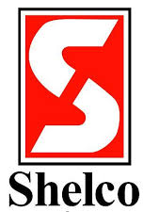
Server Virtualization
Case Study of Server Virtualization
The Challenge
Shelco had a number of servers reaching the end of their lifecycle. In today’s environment, it was imperative for Shelco to find a cost-effective way to improve the end user’s experience with Shelco systems. Rather than replacing hardware, Shelco was looking to virtualize on a SAN.
The Solution
AT-NET Services, Inc. installed a server virtualization solution utilising Cisco UCS Servers, VMware, and a NetApp Storage Area Network (SAN). The virtual server solution included: Physically staging the servers and SAN, configuration of the local network, servers and SAN, virtualizing seven servers, configuring backups and performing administrative training.
The Impact
“The completed project has enabled Shelco to replace our aging physical servers with virtual machines. SAN performance has improved our end user experience and provided an enhanced capability for backup and disaster recovery planning. Our interaction with the AT-NET team was outstanding. They did an outstanding job of understanding our needs and tailoring the initial proposal to win the job.”
Source: https://www.expertip.net/wp-content/uploads/2016/04/shelco.pdf

Slide 11
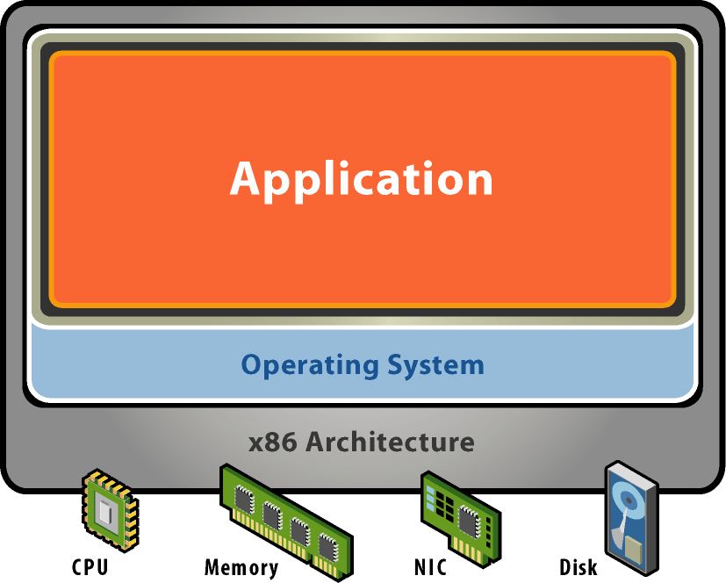
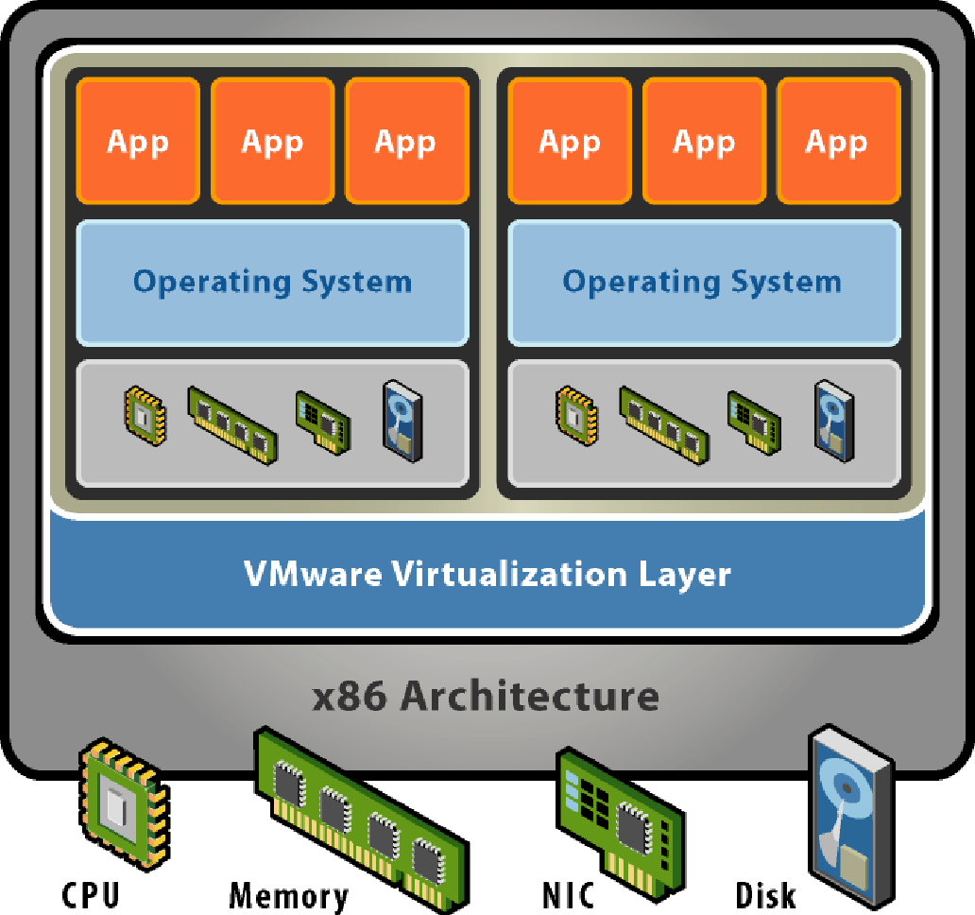
What is Virtualization?
Initially the computer hardware was designed to run a single operating system and a single application as shown in the following Figure 1, leaving most machines vastly underutilised.
Figure 1: A Physical Machine Figure 2: Virtualization Architecture
Source: https://blogs.sap.com/wp-content/uploads/2014/05/figure1_462528.png Source: https://blogs.sap.com/2014/05/28/a-brief-intro-of-virtualization-and-vmware-esxi/
The solution to the above problem is virtualization. Virtualization is the ability to run multiple operating systems on a single physical system and share the underlying hardware resources as shown in Figure 2.
Virtualization is one of the hardware reducing, cost saving and energy saving technology that is rapidly transforming the IT landscape and fundamentally changing the way that people compute.
In computing, virtualization means to create a virtual version of a device or resource, such as a server, storage device, network or even an operating system where the framework divides the resource into one or more execution environments.

Slide 12
What is virtualization? (Continued..)
Virtualization is a proven software technology that is rapidly transforming the IT landscape and fundamentally changing the way people compute.
Today’s powerful x86 computer hardware (x86 is a generic name for the series of Intel microprocessor families that began with the 80286 microprocessor) was originally designed to run only a single operating system and a single application, but virtualization breaks that bond, making it possible to run multiple operating systems and multiple applications on the same computer at the same time, increasing the utilisation and flexibility of hardware.
Virtualisation is a technology that can benefit anyone who uses a computer, from IT professionals, commercial businesses and government organisations.
Join millions of people around the world who use virtualization to save time, money and energy while achieving more with the computer hardware they already own.
Source: http://www.tuscom.com/home/networks/virtualization/

Slide 13
How does Virtualization Work?
In essence, virtualization lets you transform hardware into software
Use software, such as, VMware ESX to transform or “virtualize” the hardware resources of an x86-based computer including the CPU, RAM, hard disk and network controller — to create a fully functional virtual machine that can run its own operating system and applications just like a “real” computer
Multiple virtual machines share hardware resources without interfering with each other so that one can safely run several operating systems and applications at the same time on a single computer

Slide 14
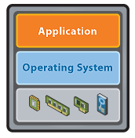
Jargons in Virtualization
Virtual Machine
A virtual machine is a tightly isolated software container that can run its own operating systems and applications as if it were a physical computer
A virtual machine behaves exactly like a physical computer and contains its own virtual (that is, software-based) CPU, RAM hard disk and network interface card (NIC)
An operating system can’t tell the difference between a virtual machine and a physical machine, nor can applications or other computers on a network. Even the virtual machine thinks it is a “real” computer
Nevertheless, a virtual machine is composed entirely of software and contains no hardware components whatsoever. As a result, virtual machines offer a number of distinct advantages over physical hardware
Benefits of Virtual Machines:
Compatibility: They are compatible with all standard x86 computers.
Isolation: They are isolated from each other as if physically separated.
Encapsulation: They encapsulate a complete computing environment.
Hardware independence: They run independently of underlying hardware.
Source: http://www.tuscom.com/home/networks/virtualization/

Slide 15
Jargons in Virtualization (Continued..)
Hypervisor
If virtualization is defined as the enabling multiple operating systems to run on a single host computer, then the essential component in the virtualization stack is the hypervisor.
This hypervisor, also called Virtual Machine Monitor (VMM), creates a virtual platform on the host computer, on top of which multiple guest operating systems (a guest OS is the software installed on either a virtual machine or partitioned disk that describes an operating system that is different from the host operating system) are executed and monitored. This way, multiple operating systems, which are either multiple instances of the same operating system, or different operating systems, can share the hardware resources offered by the host.
Hypervisors are commonly classified as one of the following two types:
Type 1: Native or Bare Metal
Type 2: Hosted
Notes:
Type 1: Native or Bare Metal
Native hypervisors are software systems that run directly on the host's hardware to control the hardware and to monitor the guest operating systems. Consequently, the guest operating system runs on a separate level above the hypervisor. Examples of this classic implementation of virtual machine architecture are Oracle VM, Microsoft Hyper-V, VMware ESX and Xen.
Type 2: Hosted
Hosted hypervisors are designed to run within a traditional operating system. In other words, a hosted hypervisor adds a distinct software layer on top of the host operating system and the guest operating system becomes a third software level above the hardware. A well-known example of a hosted hypervisor is Oracle VM VirtualBox. Others include VMware Server and Workstation, Microsoft Virtual PC, KVM, QEMU and Parallels.

Slide 16
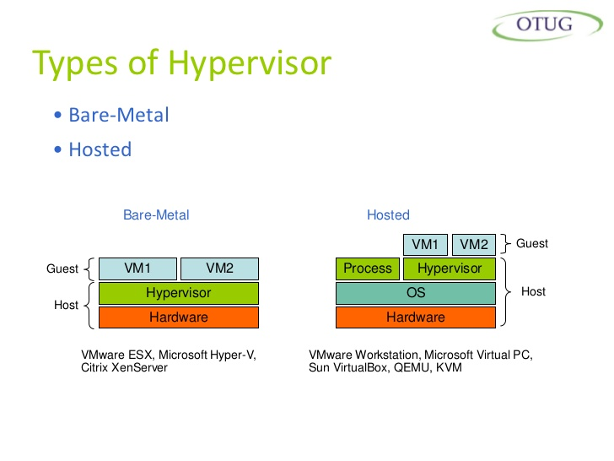
Type 1 or Bare Metal Hypervisor
A bare-metal virtualization hypervisor does not require admins to install a server operating system first
Bare-metal virtualization means the hypervisor has direct access to hardware resources, which results in better performance, scalability and stability
One disadvantage of a bare-metal virtualization hypervisor is that hardware support is typically more limited, because the hypervisor usually has limited device drivers built into it
Bare-metal virtualization is well suited for enterprise data centres, because it usually comes with advanced features for resource management, high availability and security. Admins can centrally manage this kind of virtualization hypervisor, which is critical when you one have has many hosts in their virtual infrastructure
The most popular bare-metal virtualization hypervisors are:
VMware ESX and ESXi
Microsoft Hyper-V
Citrix Systems XenServer

Slide 17
Type 2 or Hosted Hypervisor
Unlike the bare-metal virtualization hypervisor, a hosted hypervisor requires you to first install an OS. These hypervisors are basically like applications that install on a guest OS. This approach provides better hardware compatibility than bare-metal virtualization, because the OS is responsible for the hardware drivers instead of the hypervisor
There are some disadvantages with bare-metal hypervisor; a hosted virtualization hypervisor does not have direct access to hardware and must go through the OS, which increases resource overhead and can degrade virtual machine (VM) performance
Hosted hypervisors are common for desktops, because they allow you to run multiple operating systems. These virtualization hypervisor types are also popular for developers to maintain application compatibility on modern operating systems
The most popular hosted virtualization hypervisors are:
VMware Workstation, Server, Player and Fusion
Oracle VM VirtualBox
Microsoft Virtual PC
Parallels Desktop
searchservervirtualization.techtarget.com/tip/Understanding-hosted-and-bare-metal-virtualization-hypervisor-types

Slide 18
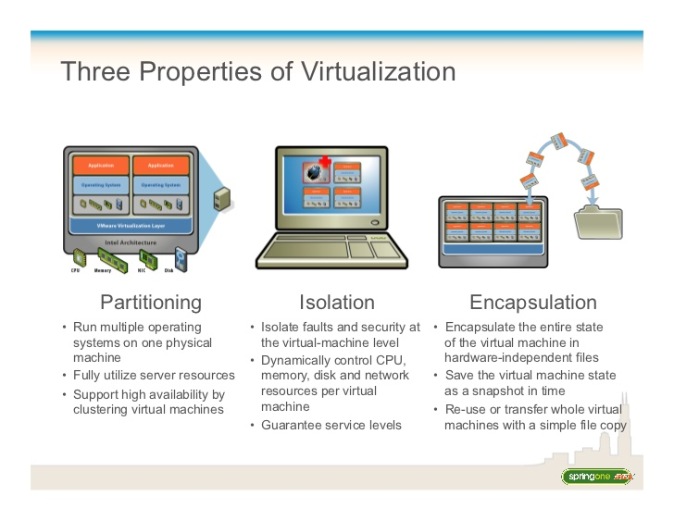
Characteristics of Virtualization
Virtualization has three characteristics that make it ideal for cloud computing:
Partitioning:
Runs multiple operating systems on one physical machine
Utilises server resources completely
Supports high availability by clustering virtual machines
Isolation:
Isolates faults and security at virtual machine level
Dynamically controls CPU, memory, disk and network resources per virtual machine
Encapsulation:
Encapsulates the entire state of the virtual machine in hardware independent files
Saves the virtual machine state as a snapshot in time
Re-uses or transfers whole virtual machines with a simple file copy

Slide 19
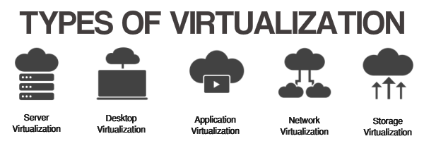
Different types of virtualization
Server Virtualization: Server virtualization allows for more than one server to operate on the same piece of hardware.
Desktop Virtualization: Desktop virtualization is a software technology that separates the desktop environment and associated application software from the physical client device that is used to access it.
Application Virtualization: In application virtualization, a given application is a single platform that can be executed on virtually any other machine.
Network Virtualization: Network virtualization is using network resources through a logical segmentation of a single physical network.
Storage Virtualization: Storage virtualization is the pooling of physical storage from multiple network storage devices into what appears to be a single storage device that is managed from a central console.

Slide 20
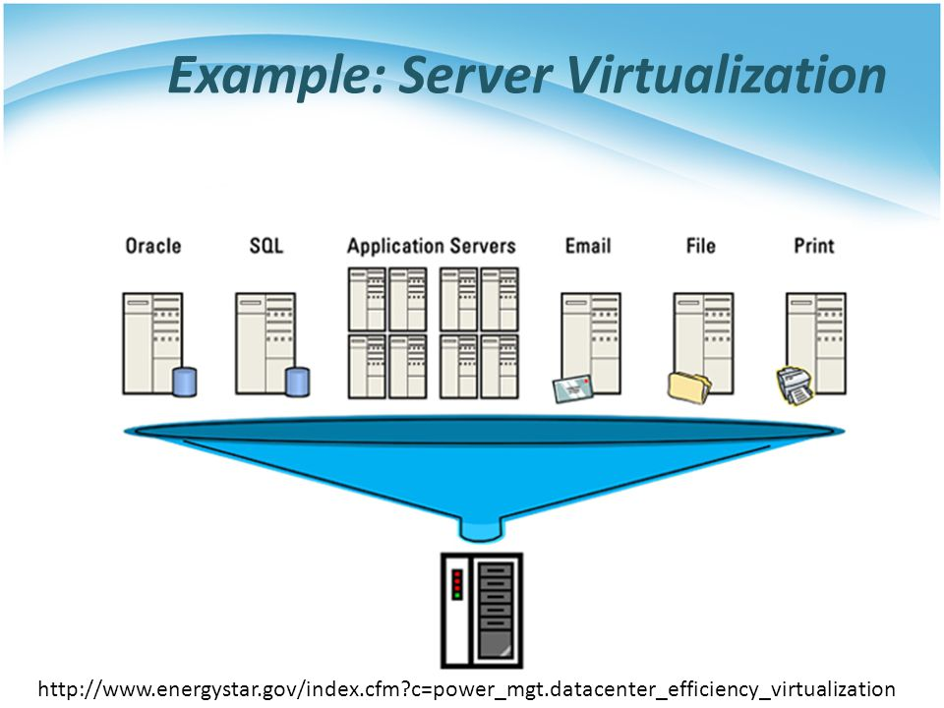
Server Virtualization
Server virtualization is the most active segment of the virtualization industry featuring established companies, such as VMware, Microsoft and Citrix
With server virtualization one physical machine is divided into many virtual servers
At the core of such virtualization is the concept of a hypervisor (virtual machine monitor)
A hypervisor is a thin software layer that intercepts operating system calls to hardware. Hypervisors typically provide a virtualized CPU and memory for the guests running on top of them. The term was first used in conjunction with the IBM CP-370
Source: http://slideplayer.com/slide/3293493/

Slide 21
Benefits of Server Virtualization
Increased Hardware Utilisation
Security
Development
Source: https://www.infoq.com/articles/virtualization-intro
Notes:
Increased Hardware Utilisation: This results in hardware saving, reduced administration overhead and energy savings.
Security: Clean images can be used to restore compromised systems. Virtual machines can also provide sandboxing and isolation to limit attacks.
Development: Debugging and performance monitoring scenarios can be easily setup in a repeatable fashion. Developers also have easy access to operating systems they might not otherwise be able to install on their desktops.

Slide 22
Desktop Virtualization
Desktop virtualization is a virtualization technology that separates an individual's PC applications from his or her desktop
Virtualized desktops are generally hosted on a remote central server, rather than the hard drive of the personal computer
The client-server computing model is used in virtualizing desktops, desktop virtualization is also known as client virtualization
Benefits of Desktop Virtualization include:
A lower total cost of ownership (TCO)
Increased security
Reduced energy costs
Reduced downtime and centralised management

Slide 23
Application Virtualization
Application virtualization is running an application on a thin client (a thin client is a lightweight computer built to connect to a server from a remote location; the server does most of the work, which can include crunching numbers and storing information for the thin client)
A terminal or a network workstation with few resident programs and accessing most programs residing on a connected server
The thin client runs in an environment separate from, sometimes referred to as being encapsulated from, the operating system where the application is located
Benefits to application virtualization include:
Requiring fewer resources compared to using a separate virtual machine
Allowing incompatible applications to run on a local machine simultaneously
Maintaining a standard, more efficient and cost-effective OS configuration across multiple machines in a given organisation, independent of the applications being used
Source: https://www.techopedia.com/definition/573/application-virtualization

Slide 24
Network Virtualization
Network virtualization refers to the management and monitoring of an entire computer network as a single administrative entity from a single software-based administrator’s console
Network virtualization is designed to allow network optimization of data transfer rates, flexibility, scalability, reliability and security
Benefits of Network Virtualization include:
Customisation of Access: Administrators can quickly customise access and network options, such as, bandwidth throttling and quality of service
Consolidation: Physical networks can be combined into one virtual network for overall simplification of management
Source: https://www.techopedia.com/definition/655/network-virtualization

Slide 25
Storage Virtualization
Storage virtualization is the process of grouping the physical storage from multiple network storage devices so that it looks like a single storage device. The process involves abstracting and covering the internal functions of a storage device from the host application, host servers or a general network in order to facilitate the application and network-independent management of storage.
Benefits of Storage Virtualization include:
Migration: Data can be easily migrated between storage locations without interrupting live access to the virtual partition with most technologies.
Utilization: Similar to server virtualization, utilisation of storage devices can be balanced to address over and underutilisation.
Management: Many hosts can leverage storage on one physical device that can be centrally managed.
Source: https://www.techopedia.com/definition/4798/storage-virtualization

Slide 26
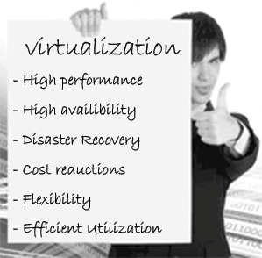
Overall Benefits of Virtualization
Virtualization can increase IT agility, flexibility and scalability while creating significant cost savings
Workloads get deployed faster
Performance and availability increases
Operations become automated, resulting in IT that's simpler to manage and less costly to own and operate
Reduce capital and operating costs
Minimise or eliminate downtime
Increase IT productivity, efficiency, agility and responsiveness
Provision applications and resources faster
Enable business continuity and disaster recovery
Simplify datacenter management
Build a true software-defined datacenter

Slide 27

Virtualization use cases
There is perhaps no better use case for virtualized desktops than in education sector:
Desktop virtualization combined with a bring-your-own-device (BYOD) consumption model is a great fit for education
By offering Desktops as a Service (DaaS) to the students, schools/colleges/university can reduce costs and complexity while delivering significant enhancements to the learning experience
Rather than a school providing a system, with DaaS students are assigned a desktop virtual machine that they connect to over the network
Source: https://blog.equinix.com/blog/2011/12/21/desktop-virtualization-use-cases-education/

Slide 28
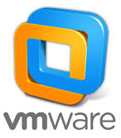
Virtualization vendors in IT industry
VMware
VMware dominates the server virtualization market
Its domination doesn't stop with its commercial product, VMware vSphere
VMware also dominates the desktop-level virtualization market and perhaps even the free server virtualization market with its VMware Server product
VMware remains in the dominant spot due to its innovations, strategic partnerships and rock-solid products
Source: https://www.vskills.in/certification/tutorial/cloud-computing/vendor-offerings/

Slide 29
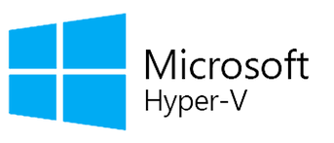
Virtualization vendors in IT industry (Continued..)
Microsoft
Microsoft came up with the only non-Linux hypervisor, Hyper-V, to compete in a tight server virtualization market that VMware currently dominates
Not easily outdone in the datacenter space, Microsoft offers attractive licensing for its Hyper-V product and the operating systems that live on it
For all Microsoft shops, Hyper-V is a viable solution that has only gotten more competitive in the virtualization space with each new Windows’ Server release
Microsoft has also been steadily gaining traction with enterprises looking to leverage the company's Azure cloud services as well as those interested in managing both on-premises Hyper-V services and Azure service
Source: https://www.vskills.in/certification/tutorial/cloud-computing/vendor-offerings/

Slide 30
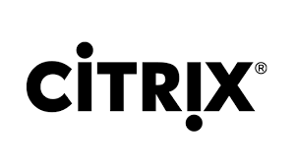
Virtualization vendors in IT industry (Continued..)
Citrix
Citrix was once the lone wolf of application virtualization, but now it also owns the world's most-used cloud vendor software called Xen (the basis for its commercial XenServer)
Amazon uses Xen for its Elastic Compute Cloud (EC2) service and so do Rackspace, Carpathia and SoftLayer
Source: https://www.vskills.in/certification/tutorial/cloud-computing/vendor-offerings/

Slide 31
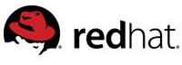
Virtualization vendors in IT industry (Continued..)
Red Hat
For the past 15 years, everyone has recognised Red Hat as an industry leader and open source champion
Hailed as the most successful open source company, Red Hat entered the world of virtualization in 2008 when it purchased Qumranet and with it, its own virtual solution: KVM and SPICE (Simple Protocol for Independent Computing Environment)
Red Hat released the SPICE protocol as open source in December 2009. The company's renowned Red Hat Enterprise Virtualization (RHEV) desktop and server virtualization platform is based on the KVM hypervisor and Red Hat's Enterprise Linux (RHEL) server operating system
RHEV is based on open standards and works with Linux and Windows, as well as enterprise applications, such as, SAP, SAS and Oracle
Source: https://www.vskills.in/certification/tutorial/cloud-computing/vendor-offerings/

Slide 32
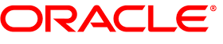
Virtualization vendors in IT industry (Continued..)
Oracle
If Oracle's world domination of the enterprise database server market doesn't impress you, its acquisition of Sun Microsystems has made it an impressive virtualization player.
Additionally, Oracle owns an operating system (Sun Solaris), multiple virtualization software solutions (Solaris Zones, LDoms and xVM) and server hardware (SPARC). What happens when you pit an unstoppable force (Oracle) against an immovable object (the Datacenter)? You get the Oracle-centred Datacenter.
Source: https://www.vskills.in/certification/tutorial/cloud-computing/vendor-offerings/

Slide 33

Google Ganeti
The company's open source Google Ganeti cluster virtual server management software tool is built on top of existing virtualization technologies, such as, Xen or KVM and essentially serves as a wrapper around these hypervisors to help system admins set up clusters.
Source: https://www.vskills.in/certification/tutorial/cloud-computing/vendor-offerings/

Slide 34
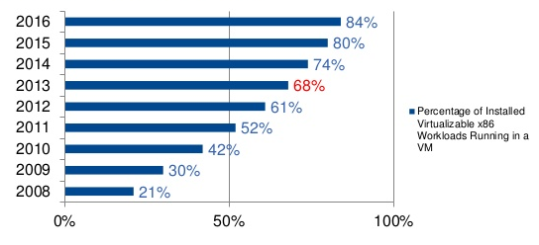
Virtualization Adoption Trend
Source: https://www.slideshare.net/beldeninc/data-center-trends

Slide 35
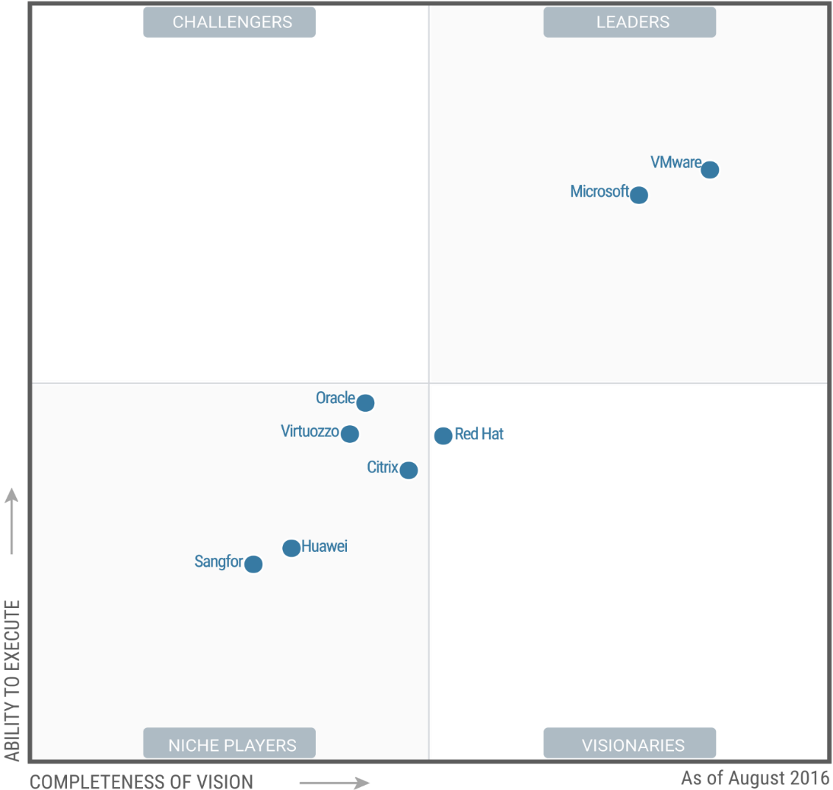
Players of Virtualization as per Gartner’s Magic Quadrant 2016
Figure: Virtualization Gartner Magic Quadrant 2016
Source: Source: Magic Quadrant for x86 Server Virtualization Infrastructure, Authors: Thomas J. Bittman, Philip Dawson, Michael Warrilow, Aug. 3, 2016​

Slide 36
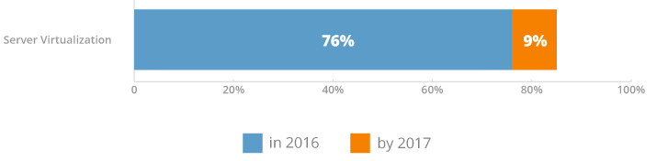
Virtualization in Current IT scenario
Virtualization usage has soared to great heights in IT. Thanks to hypervisors (such as, Hyper-V and VMware ESXi) and their ability to run multiple operating systems on a single computer, IT departments have reached new levels of efficiency and better usage of precious compute, storage and memory resources.
In fact, according to the 2016 Spiceworks State of IT report, more than 76% of organisations are taking advantage of virtualization today and that number will continue to grow in the future. Now let us take a closer look at operating systems and virtualization.
Figure: Showing the growth of virtualization in IT
Source: https://community.spiceworks.com/networking/articles/2462-server-virtualization-and-os-trends

Slide 37
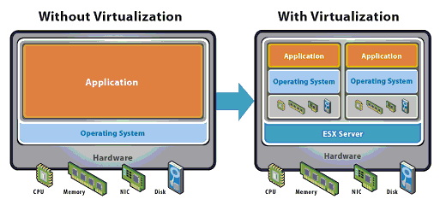
Comparing Non-Virtualized and Virtualized Environment
Non-Virtualized
Single OS image per machine
Software and hardware tightly coupled
Running multiple applications on same machine often creates conflict
Inflexible and costly infrastructure
Virtualized environment
Hardware-independent operating system and applications
Virtual machines can be provisioned to any system
Can manage operating system and application as a single unit by encapsulating them into virtual machines
Source: https://www.vmware.com/pdf/virtualization.pdf

Slide 38

Case Studies Showing Benefits of Virtualization in Enterprises
Over the past few years, virtualization has transformed the traditional datacenter
Countless businesses have reduced energy and hardware costs as more IT professionals realise the benefits of virtualization
For companies that demand more computing power, virtualization can help deliver improved performance without the need for an expanded facility or additional cooling infrastructure
Case study 1: Financial Services Company Running Out of Space
As computing needs continued to grow, an online financial services company faced a problem all too common in today’s datacenters. The company was running out of space to house physical servers and its existing cooling infrastructure couldn't keep up.
New workloads meant addition of physical systems and valuable time was spent configuring those systems and balancing power distribution. Finally, the company turned to server virtualization technology to help solve its space problems and improve efficiency. Today, the company is 75% virtualized and runs 200 VMs on just 10 physical servers, leading to an estimated 33% savings in power use.
Source: http://searchdatacenter.techtarget.com/feature/Case-studies-show-the-benefits-of-virtualization

Slide 39
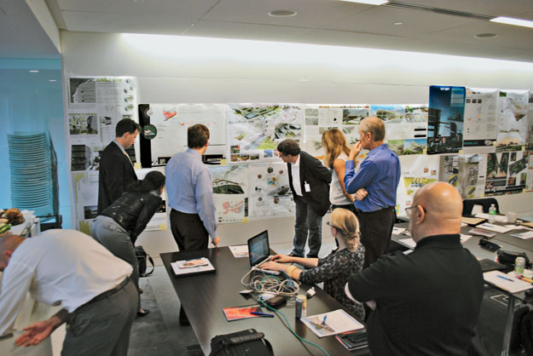
Case Study 2: Architectural Firm Uses Storage Area Network Technology in its Virtualization Rollout
Storage area networks (SANs) have become commonplace in the modern data centre and are especially valuable for virtual systems. However, it is critical to plan and budget for all the technology needed to properly deploy and manage a SAN
Planning ahead is also essential for identifying the potential costs that could surface beyond the initial SAN deployment and is key to realising the benefits of virtualization
This case study shows what happened when an IT solution provider supported a data centre virtualization project for an architectural firm that did not budget for licensing costs and SAN management tools
Source: http://searchdatacenter.techtarget.com/feature/Case-studies-show-the-benefits-of-virtualization

Slide 40

Case study 3: Healthcare Provider Sees Benefits of Virtualization
Virtualization isn't just for large datacenters supporting enterprise businesses. Even smaller organisations can use virtualization technologies to improve performance, as evidenced by this case study of a New York healthcare provider
The company's director of IT was frustrated by frequent downtime caused by aging servers and had to manoeuvre his way through long-expired warranties and self-maintenance, and eventually turned to server virtualization software
This case study illustrates why a well-built virtual infrastructure is often more reliable than its physical equivalent. It also demonstrates the other benefits of virtualization that can be realised, including high availability and increased reliability
Source: http://searchdatacenter.techtarget.com/feature/Case-studies-show-the-benefits-of-virtualization

Slide 41


